Slide 1

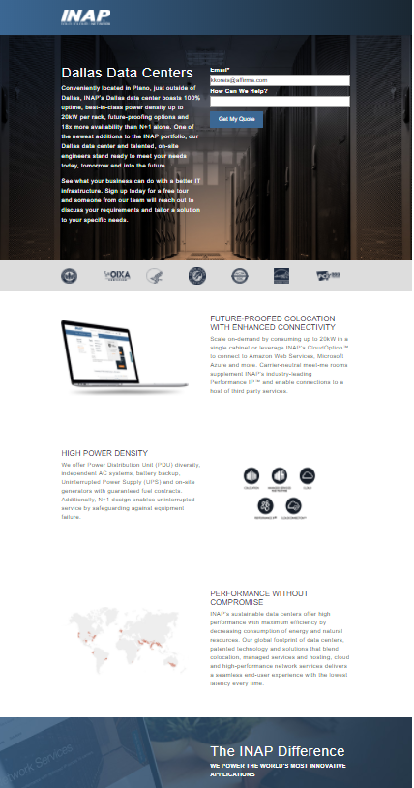

INAP – Marketing Managed Service
Business Need
INAP, a global leader in providing high-performance IT infrastructure services, was looking for assistance with the development, implementation and support of a long-term marketing plan to expand brand awareness and customer engagement as well as increase lead generation via solid inbound and outbound marketing tactics.
Although INAP has an internal marketing team, they wanted to leverage a strategic partner that could assist with a multitude of marketing tasks as needed, offer best practices and recommendations based on experience working with a variety of clients and execute work in a timely fashion.
What We Did
Affirma worked with INAP to fully understand their business and sales/marketing goals as well as performed document reviews and audits to define, set and prioritize marketing objectives, strategies and tactics. Deliverables during the initial start-up phase included specific recommendations regarding tactics, such as SEO, AdWords, social media and marketing automation as well as process improvements, such as governance and lead management.
Affirma continues to support INAP’s team through an ongoing monthly managed service agreement.

